Slide 1
Perspective of China-Pakistan
Collaboration on Business Education
In the New Era of CPEC
Zhiwen Yin, Professor
Associate Dean
School of Management,
Fudan University

Slide 2
CONTENT
CPEC – A Brief Introduction
Major Collaborations under CPEC
Collaboration in Education under CPEC
Traditional Collaboration Framework between Business Schools
Current Challenges Chinese Institutions May Encounter
Some Feasible Proposals of Initial Steps of Collaboration

Slide 3
CPEC – A Brief Introduction
China-Pakistan Economic Corridor, known as CPEC, is now considered as part of the “One Belt and One Road” development strategy proposed by Chinese President Xi Jinping
The idea of CPEC was proposed during the visit of Chinese Premier Li Keqiang to Pakistan in May 2013
CPEC was officially announced during the state visit of Chinese President Xi Jinping to Pakistan in April 2015
CPEC enhances bilateral cooperation and creates a mutually beneficial framework of collaborations between the two counties
The benefits of CPEC to Pakistan include investing on infrastructure, boosting economic development, creating job opportunities, etc.

Slide 4
Major Collaborations under CPEC
Energy Sector Projects – Energy generation is a major focus of CPEC, and the sectors include renewable energy like solar power, wind power, hydropower as well as traditional energy such as coal power and liquefied natural gas power
Gwadar Port Projects – Gwadar forms the crux of CPEC, regarded as the link between the "One Belt and One Road” and the "Maritime Silk Road”
Roadway Projects – major upgrades and overhauls to Pakistan's transportation infrastructure are expected under CPEC, including reconstruction of the Karakoram Highway and construction of the Karachi-Peshawar Highway
Railway Projects – major upgrades to Pakistan's ageing railway system, including rebuilding of the entire Main Line 1 railway between Karachi and Peshawar by 2020, which currently handles 70% of Pakistan railways traffic
Agriculture – CPEC includes provisions for cooperation in management of water resources, livestock, and other fields of agriculture

Slide 5
Collaboration in Education under CPEC
In August 2017, 9 Chinese universities and 10 Pakistani universities/institutes held a meeting in Islamabad to discuss academic collaboration between the two counties and jointly launched the CPEC Consortium of Universities
Chinese Partners (In alphabetical order) | Pakistani Partners (In alphabetical order)
Fudan University | Balochistan University of Information Technology, Engineering & Management Sciences
Hong Kong Polytechnic University | COMSATS Institute of Information Technology
Nanjing University | Institute of Business Administration, Karachi
Peking University | Institute of Business Administration, Sukkur
Shanghai Jiao Tong University | Institute of Management Sciences, Peshawar
Shanghai University | Lahore University of Management Sciences
Tsinghua University | National University of Computer and Emerging Sciences
University of Science & Technology of China | National University of Sciences & Technology
Zhejiang University | Pakistan Institute of Development Economics
 | University of the Punjab

Slide 6
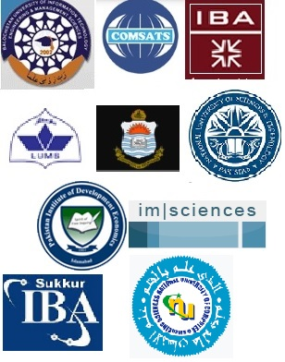
CPEC Consortium of China-Pakistan Universities

Slide 7
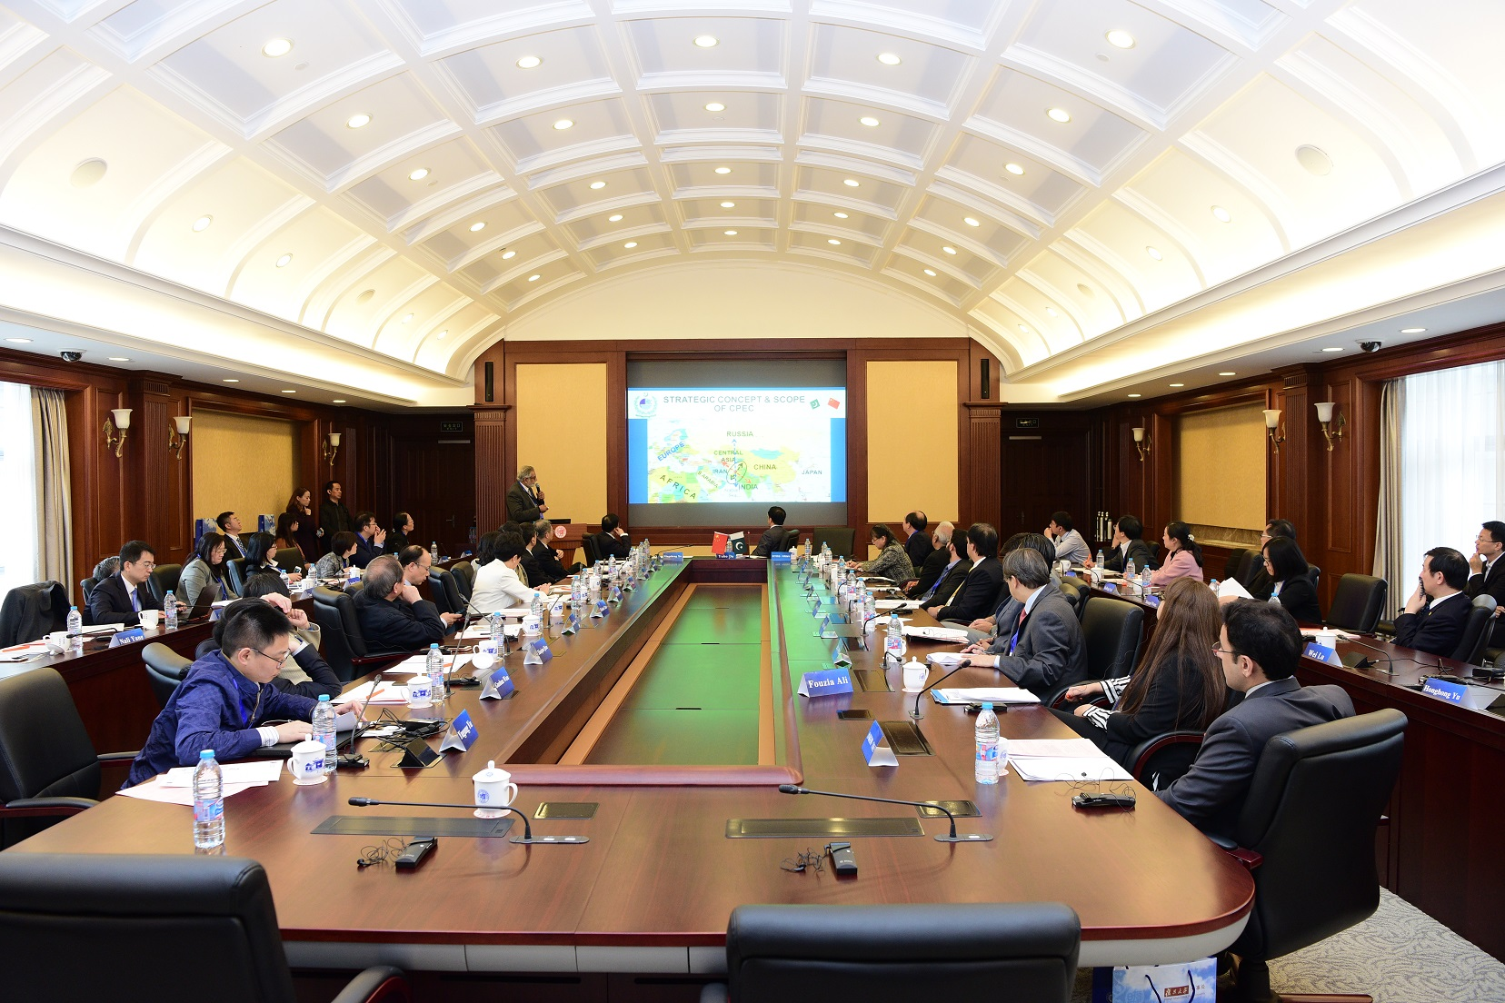
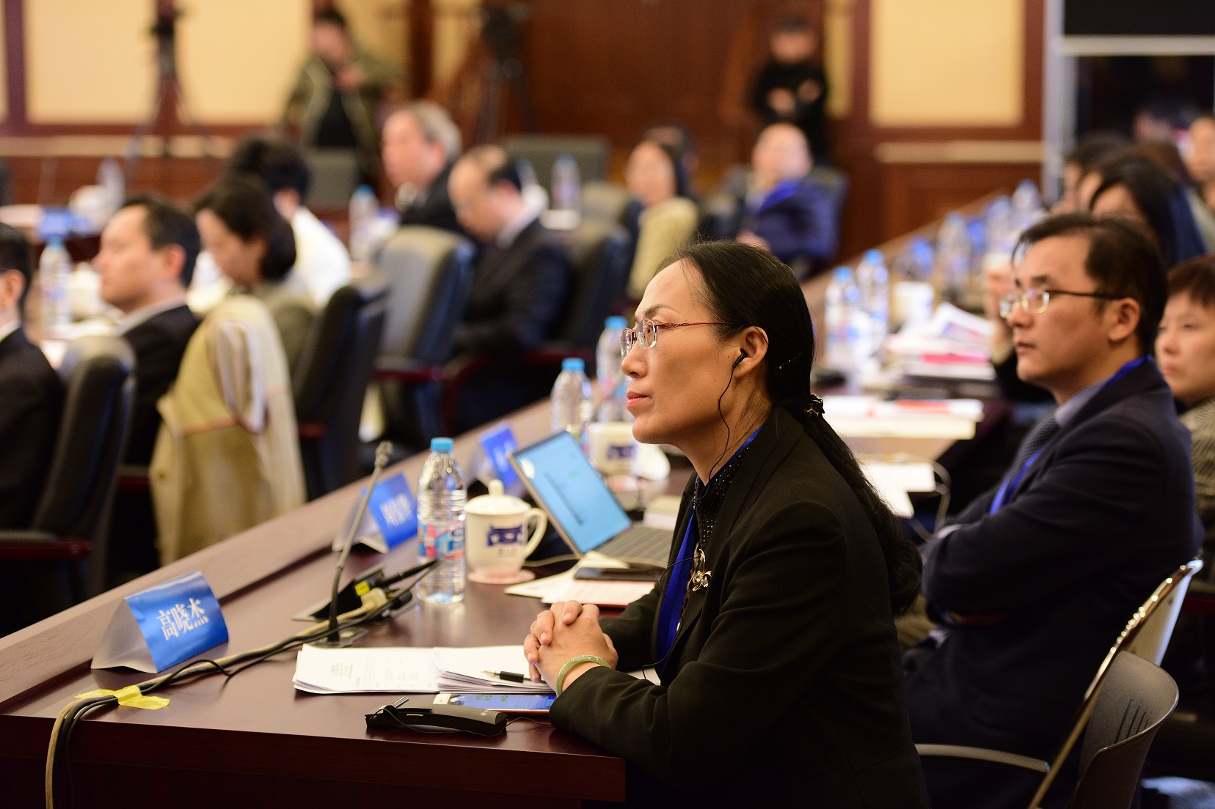
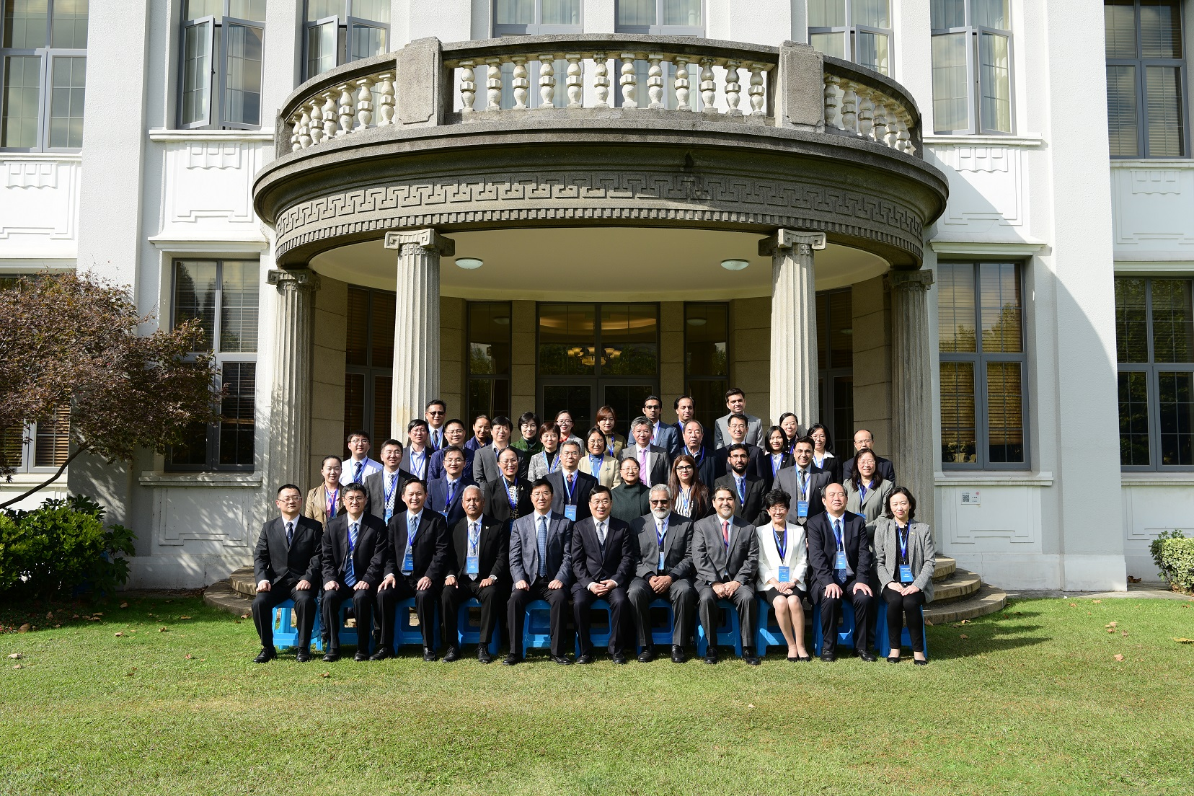
Collaboration in Education under CPEC
In November 2017, the first meeting of the CPEC Consortium of Universities was hosted by Fudan University in Shanghai with over 50 representatives from both countries attended the meeting and shared the ideas on development of collaborations in education under CPEC

Slide 8
Traditional Collaboration Framework between Business Schools
Collaborative Degree Programs – normally at bachelor’s and master’s levels, including double degree programs and joint degree programs
Faculty Joint Research Projects – faculty members from both sides can jointly bid for research funds, publish papers together, organize academic seminars, etc. and the collaborations are subject to common research interests by related faculty members
Student Exchanges – semester-long exchange studies at bachelor’s and master’s levels are the major part of student exchanges, others include jointly supervised PhD research, summer programs, short term study tours, etc.
Cross-disciplinary Collaborations – involving science, technology and engineering divisions of universities to work on multi-disciplinary projects

Slide 9
Current Challenges Chinese Institutions May Encounter
Course issues – the number, content and difficulty of courses offered by hosting schools are primary factors affecting ongoing student exchanges, and we are already under great pressure to meet current demand
Language issues – as the courses of most bachelor programs are primarily taught in Chinese, we tend to require certain level of Chinese language proficiency for incoming students
Security considerations – students and particularly their families are fairly cautious of safety factor when considering going abroad, and security is always top concern for student mobility programs
Finally, our students often lack even some basic knowledge of Pakistan, so they may hesitate to go to Pakistan at current stage

Slide 10
Proposal of Initial Steps of Collaboration
Partner School Project
Under the CPEC Consortium framework to build a number of one-on-one partner schools based on common interests and mutual agreement, aiming to facilitate collaborations between the two sides
Faculty Training Project
Faculty training workshops, Train the Trainer programs offered by Chinese side to Pakistan peers, and to help faculty members from Pakistan to develop their skills in teaching at a business school (similar like the Fudan-MIT IFF program)
Online courses and action learning project cooperation jointly developed and guided by the faculty of the partners

Slide 11
Proposal of Initial Steps of Collaboration
Student Training Project
EDP programs offered by Chinese schools for the Pakistani managers and professionals involved in the projects under CPEC
EMBA seminars, company visits or short study tours
Sponsored Student Project
With the support of government scholarship, to send PhD students of Pakistan to Chinese schools for one year co-supervised studies on CPEC related projects
With the support of government scholarship, to send students to attend short-term (1-2 weeks) Language & Culture Immersion Program offered in the partner’s country, aiming to foster the learning and understanding of culture and society of the country, and to accumulate experiences and basis for long-term student exchanges
Overall, given current situation and challenges, the proposed steps are small but applicable, and their success can enable and ensure the success of other traditional collaborations when they are ready.

Slide 12
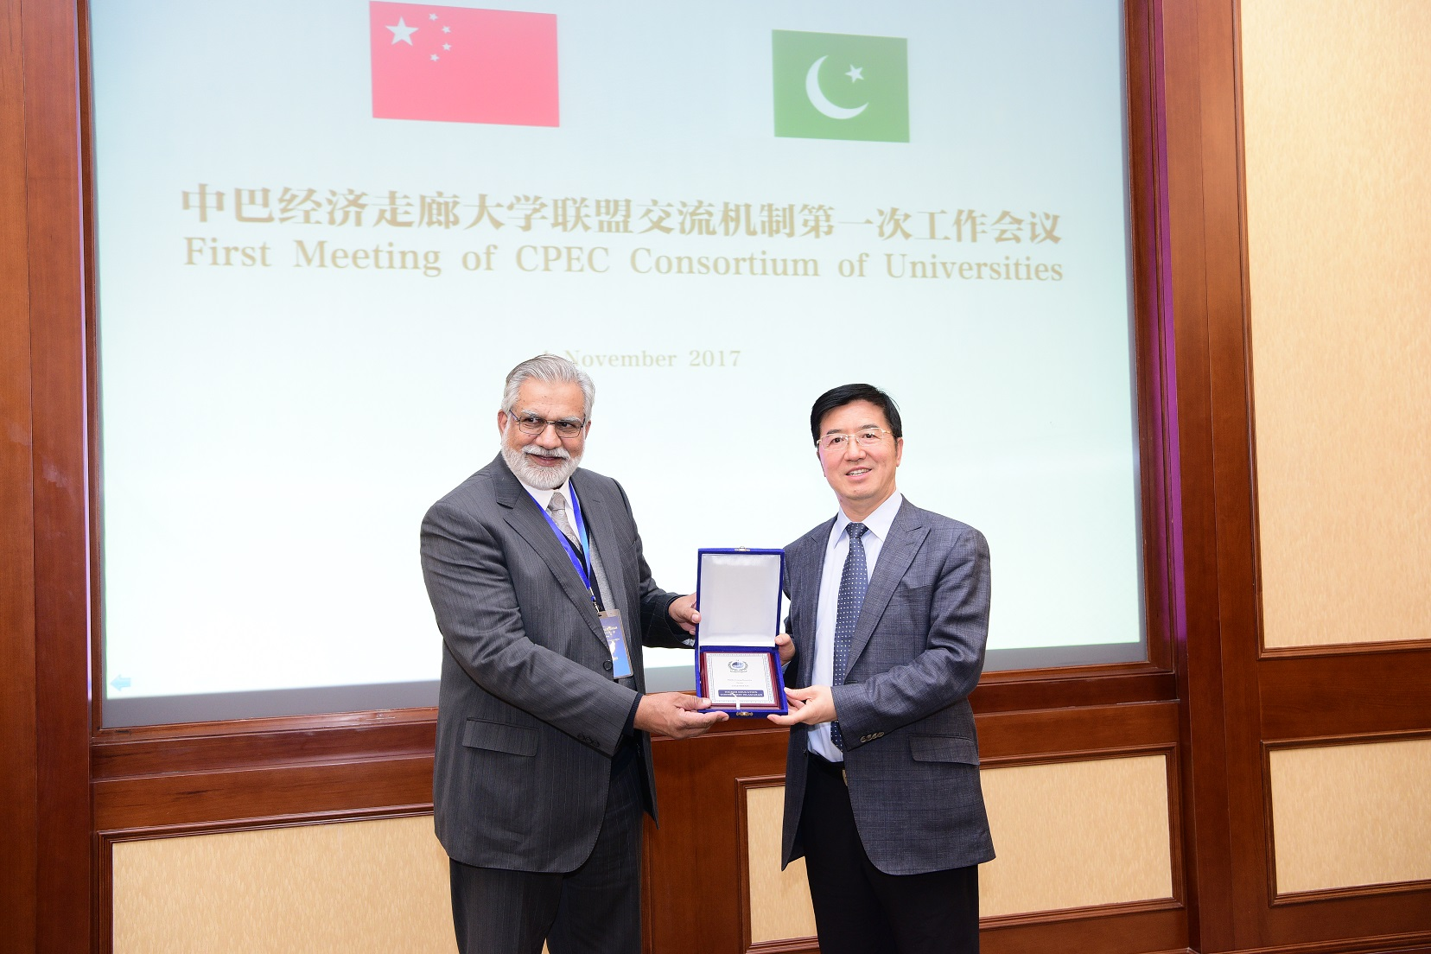
Thank You!

